Slide 1
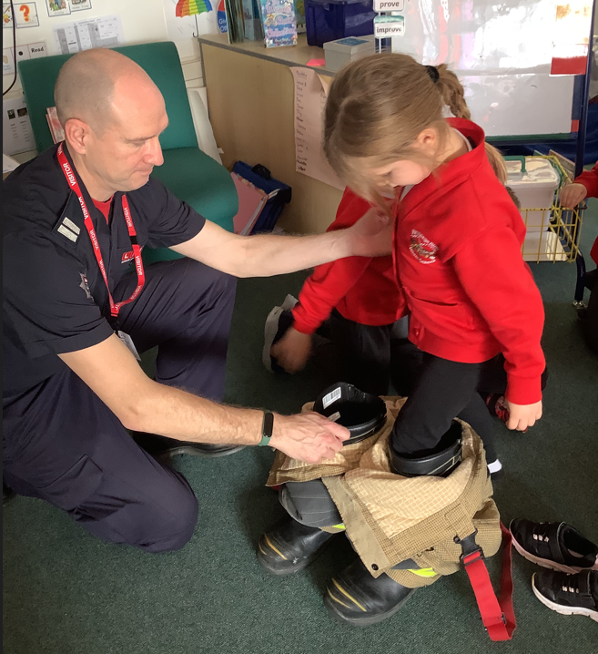
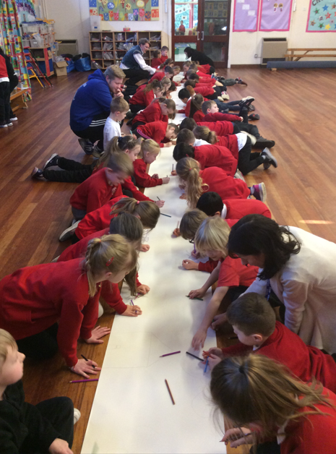
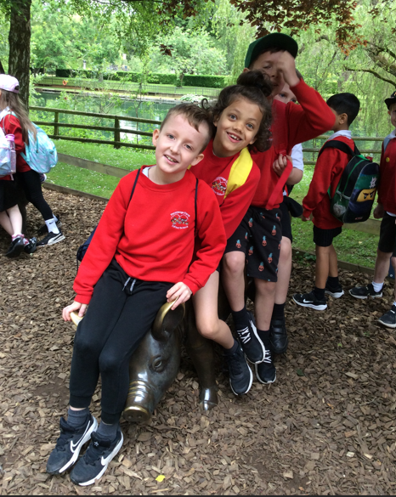
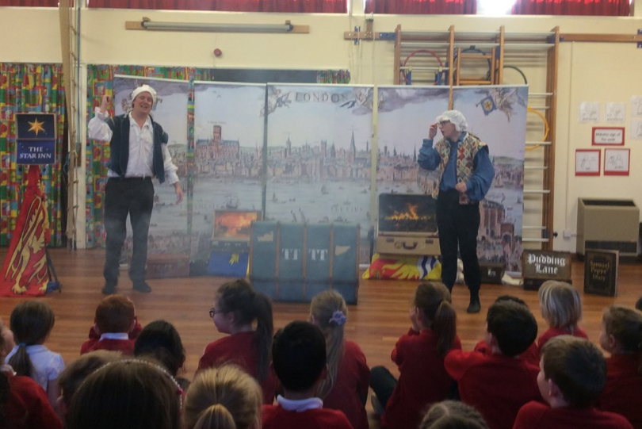
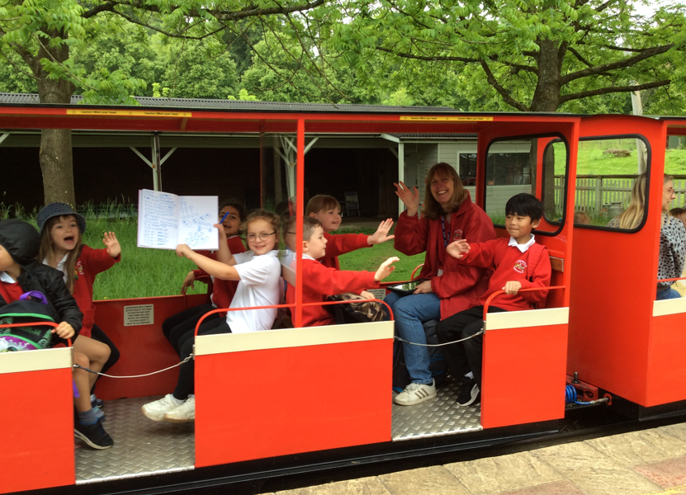
Welcome to
Year 2

Slide 2
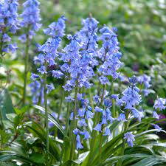
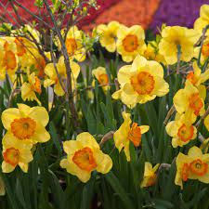
Bluebells
Daffodils
Parent Helpers
Class Teachers
Mrs Taylor
Miss Chubb
Mrs Kelly (mornings)
Class Teacher
Mrs Bowyer
Mrs Lewis (mornings)
Mrs Snell – mornings
Mrs Flowerdew - afternoons

Slide 3
Morning Routines
Main gates open at 8.40am. Please wait outside KS1 black gates/fence until opened by member of school staff.
Independence
Early morning task
Same as in Year 1!
Register at 9.00 am

Slide 4
End of Day Routines
Main gates open at 3.10pm. Please wait outside KS1 black gates/fence until opened by member of school staff.
Children sent out at 3.15pm
Same as in Year 1!
Let us know of any different people collecting.

Slide 5

Reading
Love to
Read
Similar to Year 1
Children will have:
  A phonics book which includes the phonics that have been taught so far in Year 1/2 and which your child should practise. This will be changed by a class adult when appropriate, usually once a week. (Children will not have a phonics book if they are reading without needing to use phonics! Teachers will inform you of this).
  A reading book with coloured book band. This can be changed as often as you want. Class adults indicate in reading records when your child can change their colour band.
  A red reading record. Please write any ‘home reads’ in this book.
  Please could the children have their reading books with them every day.
5 times a week.
Reading records will be collected in every week. We will check frequency of reading and make sure children have got new books if they haven’t already changed them in the week.

Slide 6



Billy Bear’s Book Bags
Reading for pleasure

Slide 7
Spelling
In school
Phonics
Common Exception Words (tricky words)
Reading Record

Slide 8
Writing
Handwriting - daily
Expectations – conjunctions, a range of punctuation, vocabulary, stamina……
Writing at home
Writing area in classrooms – to encourage a love of writing!

Slide 9
Maths
National Curriculum and Hampshire Planning
Number facts/ making links
Reasoning and questioning
Application/ problem solving
Practical – e.g. telling the time, counting, measuring…

Slide 10
Homework
Daily reading
Spellings will be emailed weekly (not tested!)
Regular Purple Mash activities to be completed
Ad hoc activities related to topic
Homework to address individual needs.

Slide 11
Learning
To see what your children are learning in each subject each term, see our website:
  Curriculum – Bluebells and Daffodils Year 2 – Knowledge in Year 2 – select the term.
  Floor books for foundation subjects.
Great Fire of London, continents and oceans, town and countryside, Georgia O’Keefe, puppets, making vehicles, Florence Nightingale and Mary Seacole, the Titanic……..……..

Slide 12
Trips
For example, last year:
Spring: Trip G Live- Guildford
Summer: Trip –e.g. Beale Park
Smaller trips e.g. Science walk

Slide 13

Child of the week
Teaching children how to give compliments
Self-esteem, confidence.

Slide 14
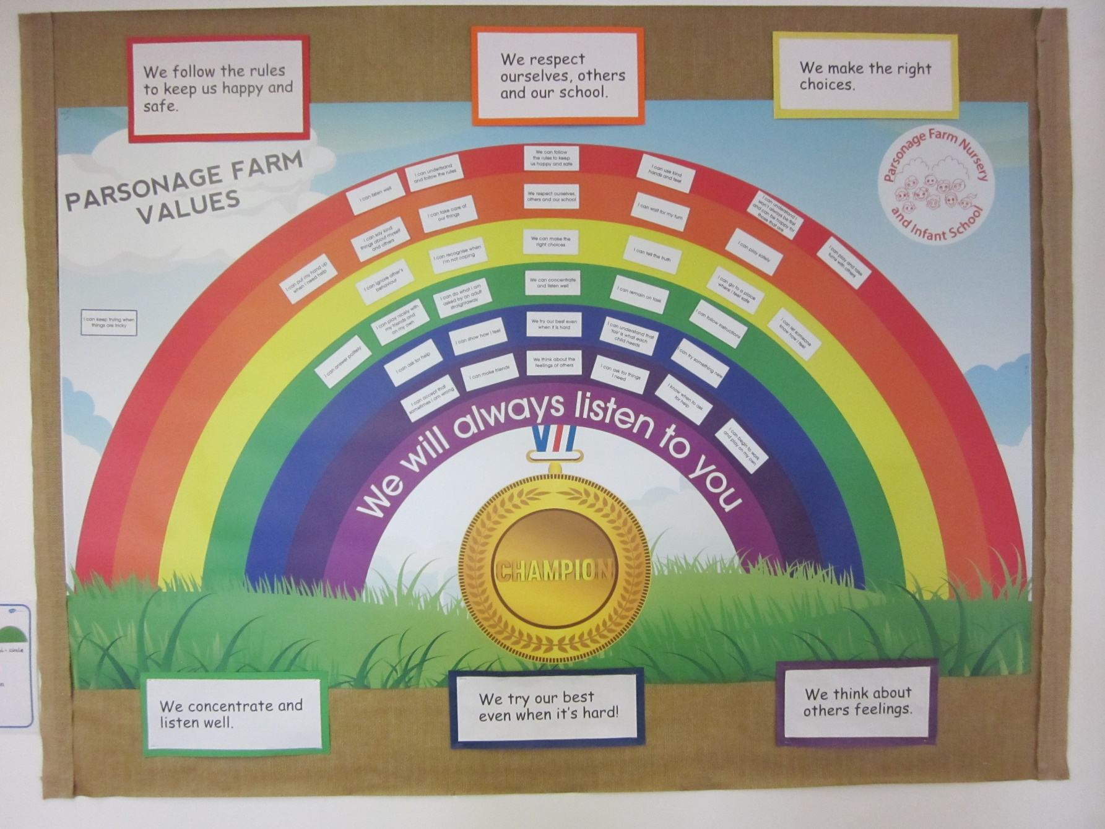
Behaviour Expectations

Slide 15
Other bits and bobs…
Please name child’s clothes
New bump notes!
Book bags – no more than 1 small keyring
Long hair tied up. No fancy hairbands etc.
Attendance
Collection at end of day
Wednesday afternoons – PE (Mr H) and Music (Mrs Gray)
PE days- Monday and Wednesday. No earrings please! Plain navy/black/grey shorts/leggings/joggers with school t-shirt and jumper/cardigan. Any leggings need to be suitable for sports!

Slide 16
Any Questions?
?
?

