Slide 1




Welcome to Year 1

Slide 2


Tulips
Sunflowers
Miss Spiller
Mrs Jasper
Mrs Harper
Mrs Haffenden
Mrs Denton 1:1
Mrs McClure
Mrs Ledgerwood
Mrs Adams

Slide 3


National Curriculum
Year 1 is the first year of the National Curriculum
It covers all subjects – maths, English (phonics, reading, writing, handwriting, speaking & listening) PE, science, geography, history, computing, art, design and technology, RE, PSHE
The National Curriculum continues until Key Stage 4 (GCSE)
Explore and learn
Notes:
Discuss things taken from Year R/ classroom layout/planning to support transition

Slide 4
Reading – Please bring books in everyday
Phonic books matched to their phonics learning and ability – changed weekly – read and re-read - ideally read this book 3 times at home to practise phonics and improve fluency
Parent comments – please record in Reading Record every time your child reads to you – whatever the book!
5 times a week
In addition - coloured book bands that can be changed as often as you like – “Love to Read”
Books from the school library
Enjoy sharing a book together – discuss, predict….enjoy! Nightly bedtime stories

Slide 5

Billy Bear’s Book Bags
There are four book bags per class and each contains a range of high quality texts. These are to continue the love of reading between you and your child.

Slide 6
Phonics
Daily phonics sessions - Twinkl
We will continue the phonics learning journey from Year R. During their time in year 1, the children will be exposed to all the sounds and common exception words from level 5.
Weekly parents phonics update by email
Phonics workshop later in the year
Lots of websites have fun, interactive phonic games (such as PhonicsPlay and Purple Mash).

Slide 7
Writing
We are continuing with Drawing club for the next few weeks. This will progress to Curious Quests, after half term… pencil control, letter formation, fun…
Learn… grammar, punctuation, letter formation, spelling, handwriting, elements of the speaking and listening curriculum… as required by the National Curriculum.
To support at home, look at our handwriting script on the school website.
We will develop sentence structure and basic punctuation. For example:
  ‘I have hair.’
  ‘I have long hair.’
  ‘I have long hair and it is brown.’
  ‘I have long hair and it is brown but my sister has short blonde hair.’

Slide 8
Maths
Continuing their work with tens frames to give children a good grasp of number and the number system
Counting (in ones, then steps of 2, 5, 10)
Learn number facts- number bonds etc.
Place value
Number formation
Addition & subtraction
Problem solving and reasoning
Real- life: measuring, weighing, telling the time, using money etc.

Slide 9
Our learning – Keep an eye on dates for book looks!
In year 1, we will also explore and learn in a variety of different subjects. This half term we are learning about…
Art
History
Science
Computing
PE
RE
Feel free to ask your class teacher about their learning journey!
Next half term, we will be learning about…
Geography instead of Hist
D&T instead of Art
Notes:
For PE – Tues = teachers Thurs = external.. Music is also Th and is external

Slide 10


Morning Routine
Gates open at 8.40 am. Please wait until a member of staff has opened the black gate. All close promptly at 9.00. Please note that we ask the same at home time.
Independence – Children put their bottles in their chosen square, move their photo onto the self-registration board put their coats and bookbags on their pegs and begin their early morning task.
Register at 9.00 am

Slide 11
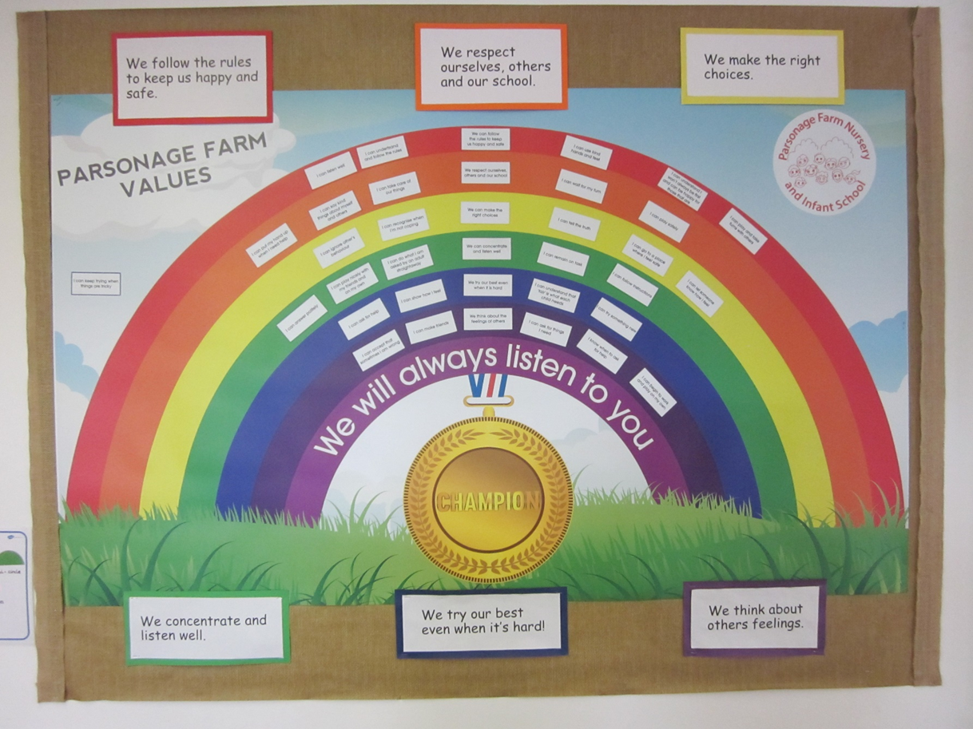
Behaviour Expectations
Star of the day
Champions
Golden coins

Slide 12

Child of the Week
Teaching children how to give compliments
Builds self-esteem and confidence
Each week one child will bring home their compliments from the other children.

Slide 13
Other bits and bobs…
Please name child’s clothes.
Book bag key rings – one to identify only
Collection at 3.15pm. A member of staff will open the black gates for you
PE – Tuesdays and Thursdays (earrings to be taken out at home) – PE kit, plain shorts, joggers, t-shirt
Parent helpers
Please check bookbags and emails for any updates.
Year1@parsonagefarm.hants.sch.uk

Slide 14


Any Questions?

