Slide 1

Parsonage Farm School
Curriculum Information
Year 2

Slide 2

What are Standard Assessment Tests (SATs)?
A series of assessments which are delivered in school. All Year 2 children will complete the assessments over a four week period in May 2017.

Slide 3

What will my child be tested on?
Reading
Writing
Grammar
Punctuation
Spelling
Maths
2 Reading Papers
Within each paper there are two fiction texts & two non-fiction texts.
There is no set writing at length paper. The class teacher will use pieces of writing from the Spring & Summer term to inform their judgments when grading.
Writing is assessed through a Grammar, Punctuation & Spelling paper.
There is a second spelling paper where children are tested on 20 spellings. A variety of spelling rules will be tested.
2 Maths Papers
1 x Arithmetic Paper
1 x Reasoning Paper

Slide 4

How are the tests administered?
In class
In small groups, with a teacher at the table
Over a four week period
Relaxed, positive atmosphere

Slide 5

How are the tests marked?
In school by the class teacher
Test Score + Teacher Assessment
Some schools are externally moderated

Slide 6



When will I find out how well my child has done?
The results of the assessments will be included with your child’s end of year report.

Slide 7
How can I help my child achieve their best?
Ensure your child is in school!
Continue to read with your child 3 – 5 times a week & complete homework activities set
Continue to read/spell the first 300 high frequency words in the front of the Reading Record
Try out some of the games and activities we show you today
Stay Positive!

Slide 8
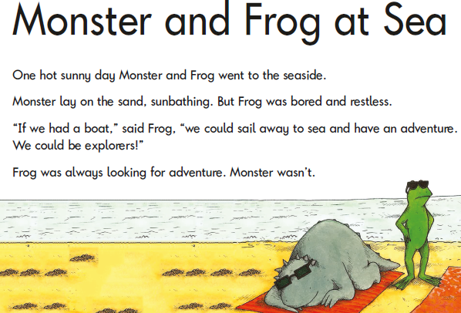

Slide 9
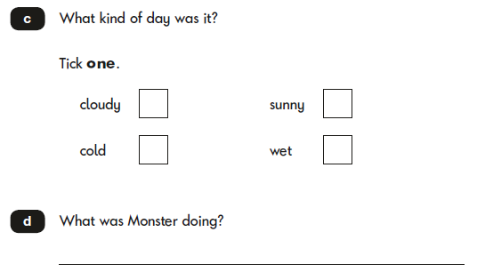

Slide 10
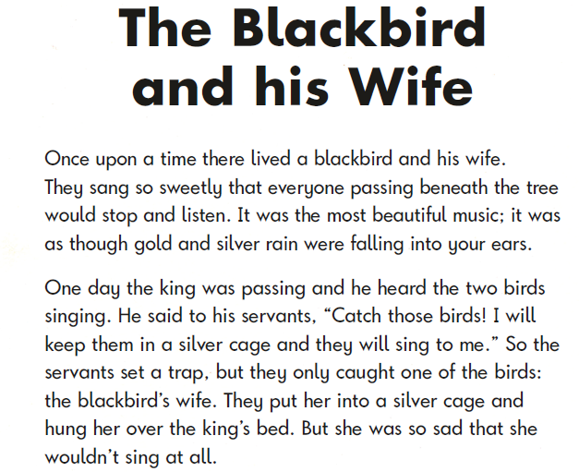

Slide 11
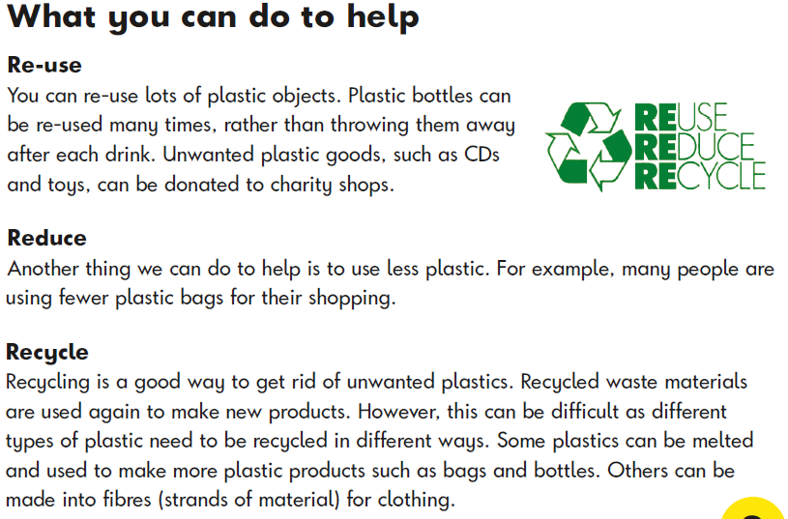

Slide 12
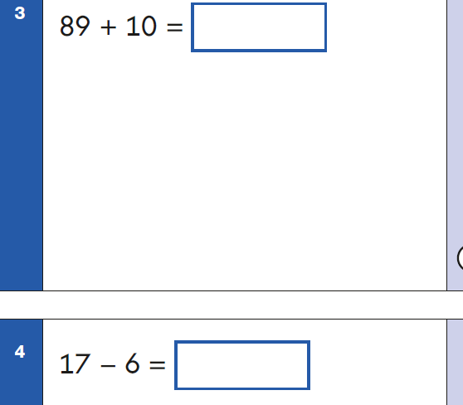

Slide 13
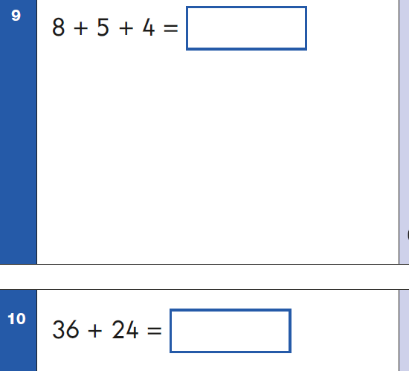

Slide 14
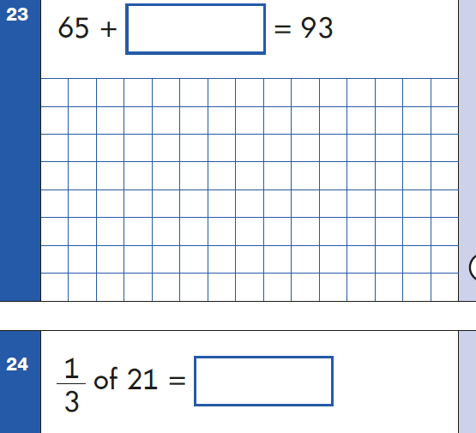

Slide 16
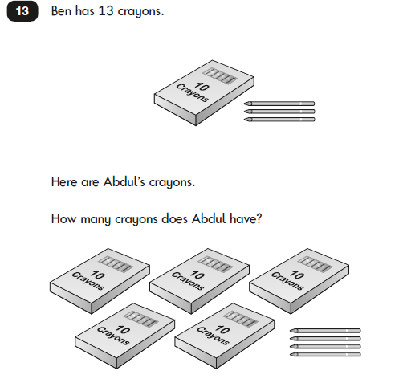

Slide 18
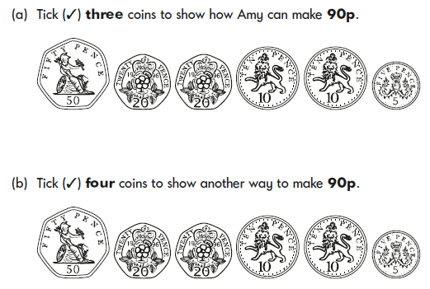

Slide 19
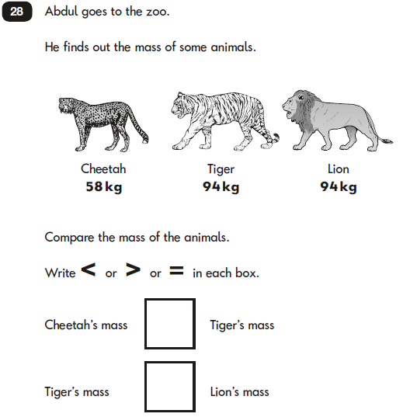

Slide 20



Click here for Sample Reading Papers
Click here for Sample Grammar,
Punctuation and Spelling Papers
Click here for Sample Maths Papers
Must be in presentation mode
to click on links.

Slide 21

Any Questions?
Please take a look at the full assessment papers on the table.

Slide 22

LINKS
READING SAMPLE PAPERS: https://www.gov.uk/government/publications/2016-key-stage-1-english-reading-sample-test-materials-mark-scheme-and-test-administration-instructions
GRAMMAR, PUNCTUATION & SPELLING: https://www.gov.uk/government/publications/2016-key-stage-1-english-grammar-punctuation-and-spelling-sample-test-materials-mark-scheme-and-test-administration-instructions
MATHS SAMPLE PAPERS: https://www.gov.uk/government/publications/2016-key-stage-1-mathematics-sample-test-materials-mark-schemes-and-test-administration-instructions

